Slide 1
BE 490: Explorations in Cardiovascular Modeling
Preeya Khanna
Benjamin Shyong

Slide 2
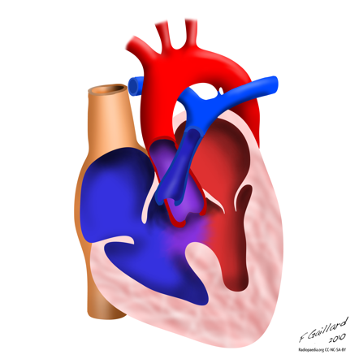
Problem: Post Surgical Tetrology of Fallot
One of the most common congenital heart defects (10% of cases)
Symptoms: Over-reaching aorta, Ventricular septal defect, Right ventricular outflow tract obstruction,Right Ventricular hypertrophy
Surgical Treatment corrects most symptoms
Post Surgical Problems:
Pulmonary Artery Stenosis
Pulmonary Valve Regurgitation

Slide 3
Objective/Design Goals
Develop a Lumped-Parameter model of the cardiovascular system that matches normal physiology
Adjust parameters in the pulmonary valve and artery to be able to match TOF patient with low error
Build a GUI that allows users of model to visualize relevant changes in physiology

Slide 4
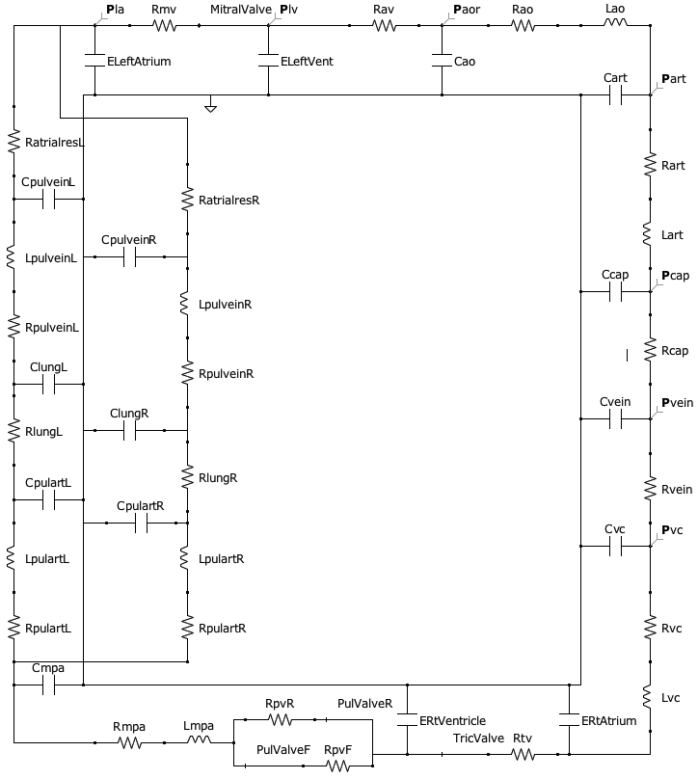
Developed Model:

Slide 5
Process of Model Development
Notes:
Circuit Development:
Simpler Models: Left Ventricle Only
Parameter Adjustment:
Ensure matching normal physiology
-Check clinical values:
-End diastolic and systolic blood pressure
-Total Systemic/Pulmonary Resistance

Slide 6
Diagrams
Pressures in Left Heart and Systemic System
Pressures in Right Heart and Pulmonary System

Slide 7
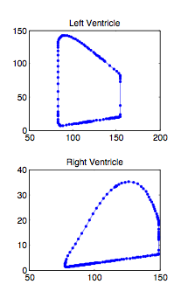
Pressure-Volume Curves

Slide 8
Actual Performance of Model
Error estimates of model in comparing results to clinical data

Slide 9
Conclusions/Recommendations

